Slide 1
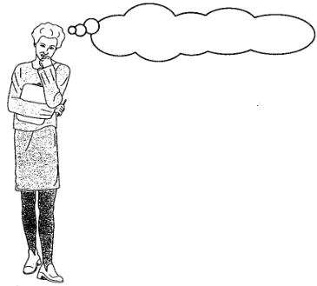
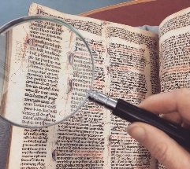
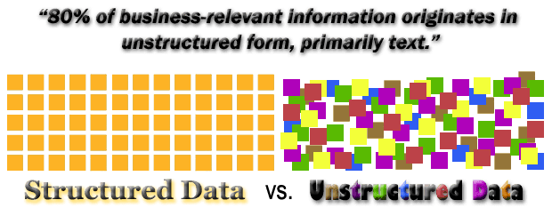
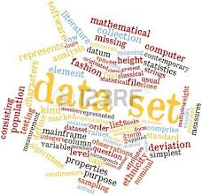
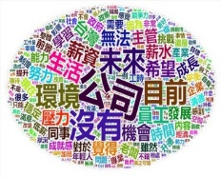

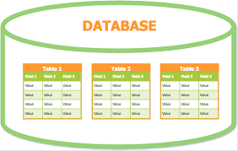








Introduction to Text Mining
????.....
English Vs. Chinese

Slide 2
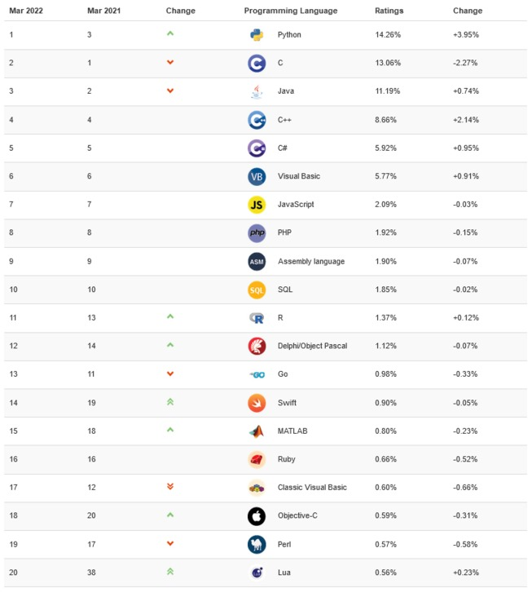
2022年3月TIOBE指數公布：Python榜首穩坐

Slide 3



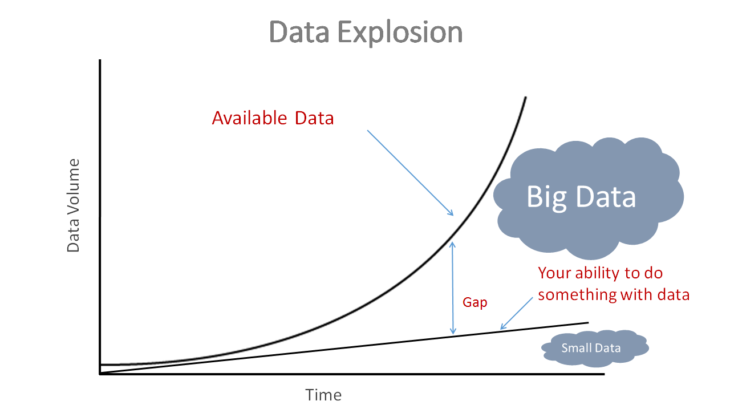
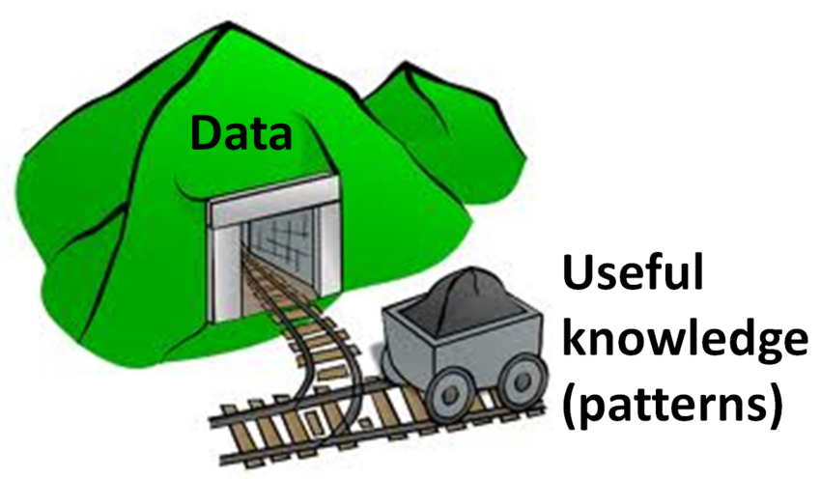
In FEB 2010

Slide 4



The Sexiest Job of the 21st Century
In October 2012
Program + Statistics + Business

Slide 5
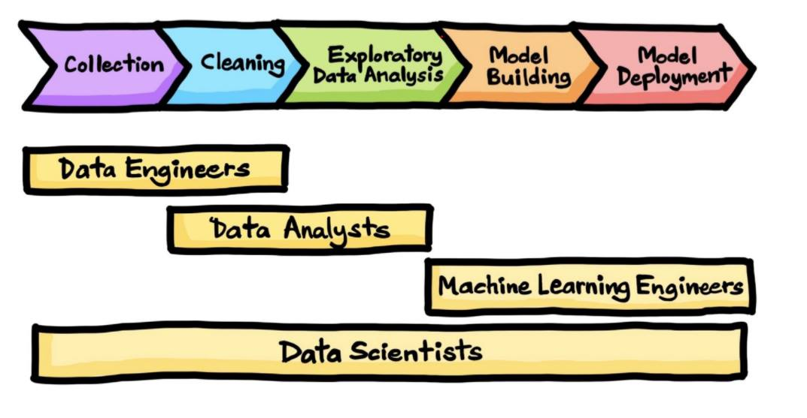
Key Talent for Digital Transformation
Prediction
Strategy
Assumption
Marketing
Simulation
Operation
Optimization
Accounting
Decision
HR
Managers with Data Science Capability

Slide 6
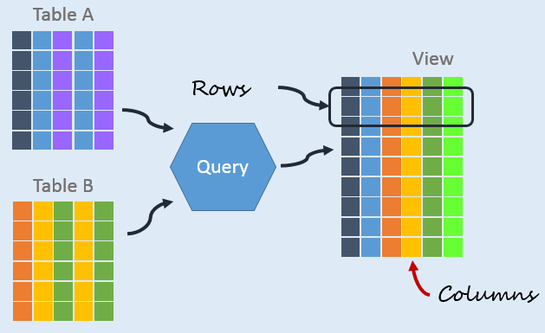
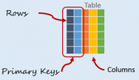




Motivation for Text Mining
Approximately 90% of the world’s data is held in unstructured formats (source: Oracle Corporation)
written
Structured Numerical or Coded
Information
10%
90%
Unstructured or Semi-structured
Information
90%

Slide 7
Motivation for Text Mining
過去有這樣的分析，Oracle(甲骨文)這些公司在處理的是Structured Data，資料量占比是10%，這樣的資料量與公司市值的關係比例為何?
所以Text mining不只在學理上有趣，在經濟上面也是一個很有機會的領域。
Market Capitalization
市場資本

Slide 8
Business Opportunity
右邊長條圖的9倍高
美國新創公司的機會與方向
Well-developed
資料量
公司市值
Market Capitalization

Slide 9






Sample Business Applications
written documents有些時候會很忠實地表達您真正的想法real opinion
豐田暴衝害命 367億和解
https://tw.news.appledaily.com/international/daily/20140321/35714931/
Decision Support in CRM
What are the customers’ typical complaints?(客戶抱怨)
Personalization in ecommerce
e.g. Line/FB/Website message or comment
Suggest products that fit a user’s interest profile
(based on personality information)
Industry
Identifying competitors’ web pages(全球競爭對手網頁資訊)
- e.g. competing products and their prices
Job seeking
Identify parameters in searching for jobs
e.g. 104 or 1111, how to write the resume or CV?
Marketing
Discover potential buyers according to a user’s text
based profile(e.g. 2 years later→new iPhone)

Slide 10
What is text mining?
…the discovery by computer of new, previously unknown information, by automatically extracting information from different written resources.
First,定義中強調written這一個字
不只是手寫的，還包含word 、power point…等等軟體環境所打字打出來的內容都算是written resources ，任何被打出來的東西都算是text。
Second,再來從這些 written resources中去找出之前沒有發現的資訊(unknown information)
Third,要能夠自動(by automatically )找到，所以使用一些Python或R等工具去written resources中自動找到一些蛛絲馬跡，這就是text mining的精神。

Slide 11
Well kids, I had an awesome birthday thanks to you. =D Just wanted to so thank you for coming and thanks for the gifts and junk. =) I have many pictures and I will post them later. hearts
What are the
characteristic words
of these two moods?
Home alone for too many hours, all week long ... screaming child, headache, tears that just won’t let themselves loose.... and now I’ve lost my wedding band. I hate this.
[Mihalcea, R. & Liu, H. (2006). A corpus-based approach to finding happiness,
In Proceedings of the AAAI Spring Symposium on Computational Approaches to Analyzing Weblogs.]
Slide based on Rada Mihalcea‘s slides in the presentation.

Slide 12



neutral
Well kids, I had an awesome birthday thanks to you. =D Just wanted to so thank you for coming and thanks for the gifts and junk. =) I have many pictures and I will post them later. hearts
current
mood:
positive
What are the
characteristic words
of these two moods?
Home alone for too many hours, all week long ... screaming child, headache, tears that just won’t let themselves loose.... and now I’ve lost my wedding band. I hate this.
current
mood:
negative
[Mihalcea, R. & Liu, H. (2006). A corpus-based approach to finding happiness,
In Proceedings of the AAAI Spring Symposium on Computational Approaches to Analyzing Weblogs.]
Slide based on Rada Mihalcea‘s slides in the presentation.

Slide 13
Positive Vs. Negative
如何看出?
有無關鍵字呢?
人腦可判斷出這兩篇文章在說什麼，那電腦呢?
學習目標
電腦有沒有辦法經由一些Preprocessing的步驟之後稍微有一點點能力可以做這樣子的判別呢?
這篇文章在說什麼?這兩篇文章像嗎?
人腦可以判斷出這兩篇文章不像，但是電腦能嗎?
人腦可以判斷出上面那篇是Positive Sentiment，下面那一篇是Negative Sentiment，那麼電腦有辦法嗎?
要如何教會電腦做這些事情呢?

Slide 14
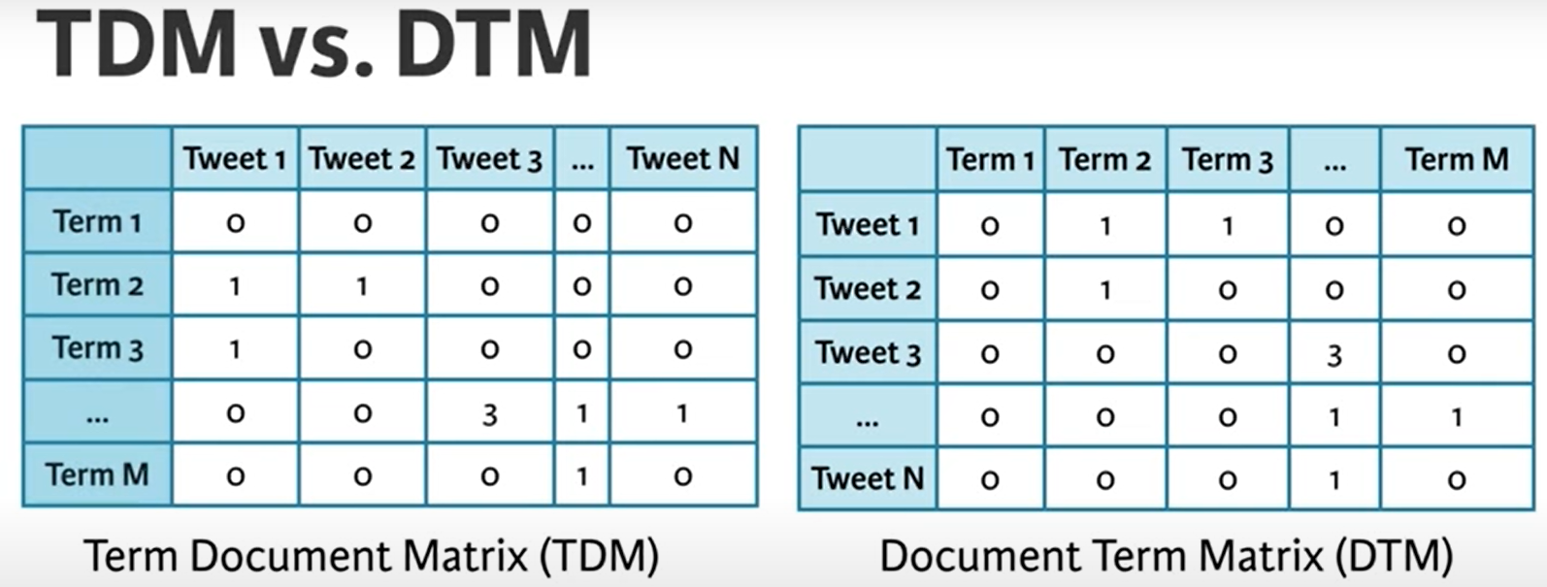
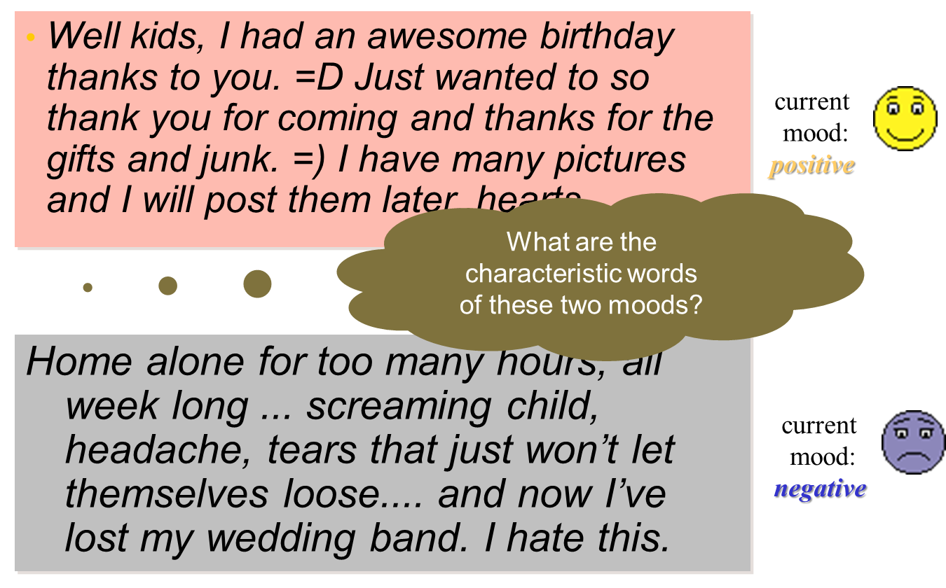
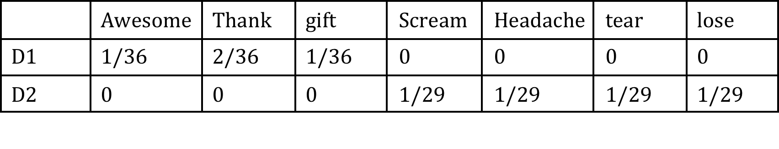
Method
Positive
Or
Negative

Slide 15
The goal: text representation
Basic idea:
Keywords are extracted from texts.
These keywords describe topical content
Based on the vector space model of document collections:
Each unique word in a corpus of Web pages = one dimension
Each page is a vector with non-zero weight for each word in that page, zero weight for other words
➔ Words become “features” (in a data-mining sense)
Column / Feature / Dimension / Attribute / Field / Term / Token / …

Slide 16
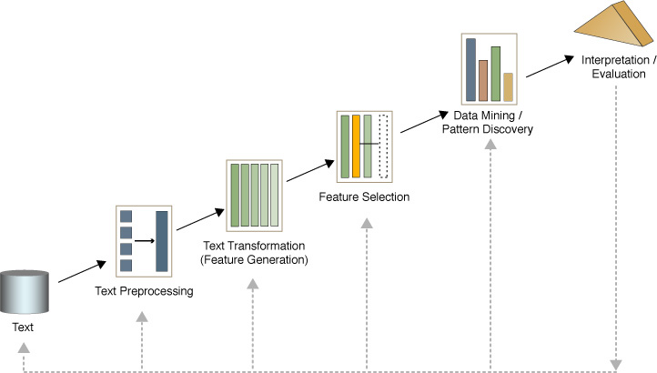
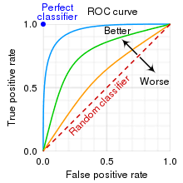
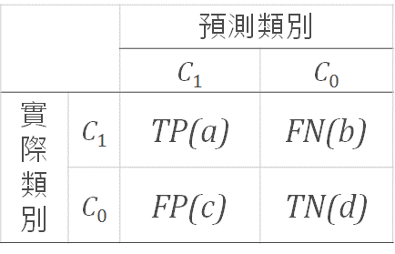

Text mining process
Text
Document Collection
Text Characteristics
Text preprocessing
Syntactic/Semantic text analysis
Feature Generation
Bag of words
Feature Selection
Text/Data Mining
Classification
Clustering
Analyzing results
真
假
真
假
$$Accuracy=\frac{a+d}{a+b+c+d}$$

Slide 17

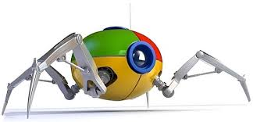
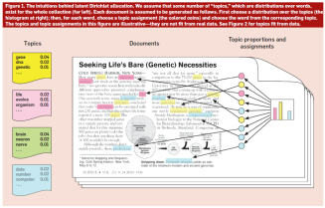

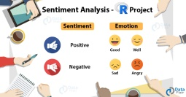
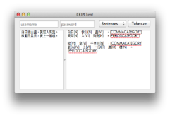
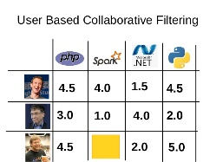
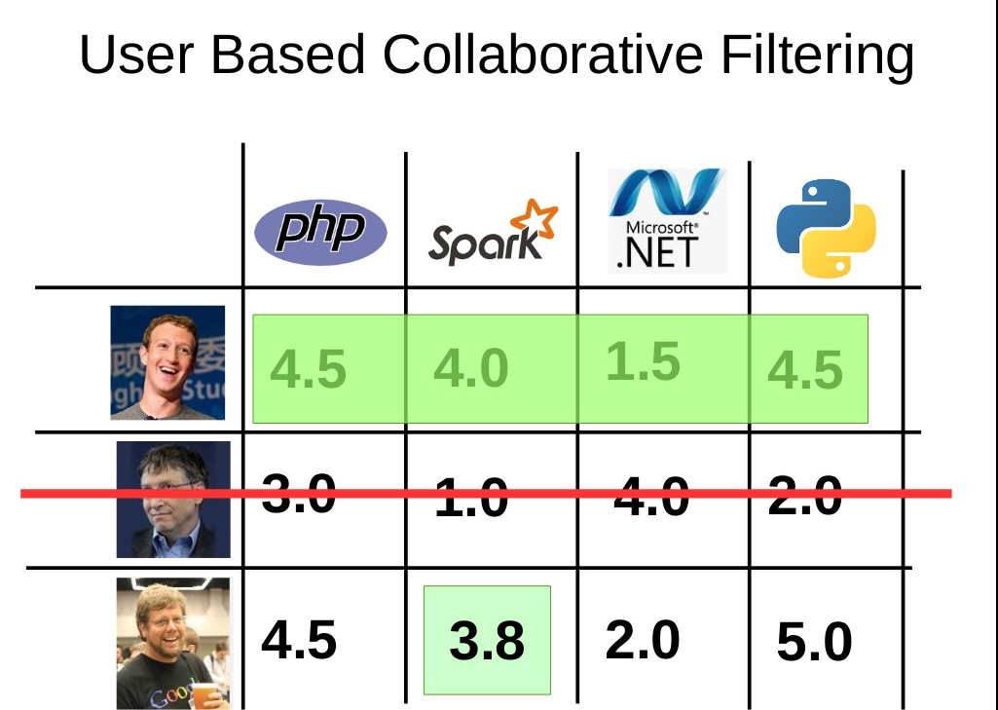
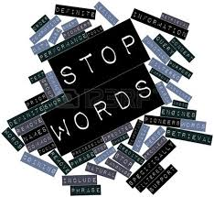
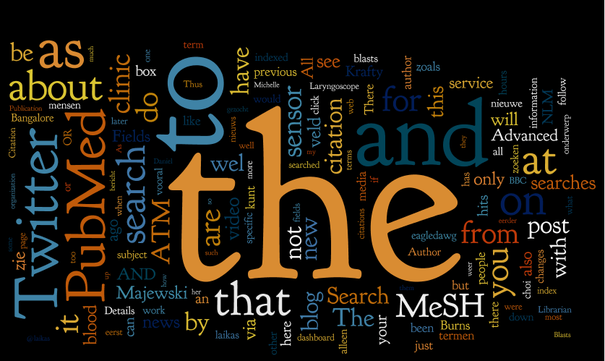
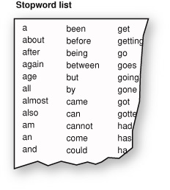
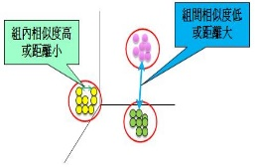
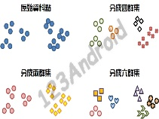
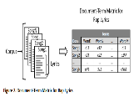
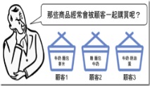
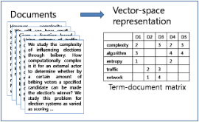
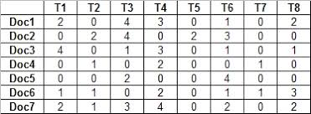
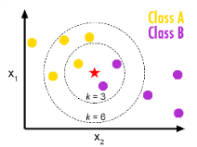
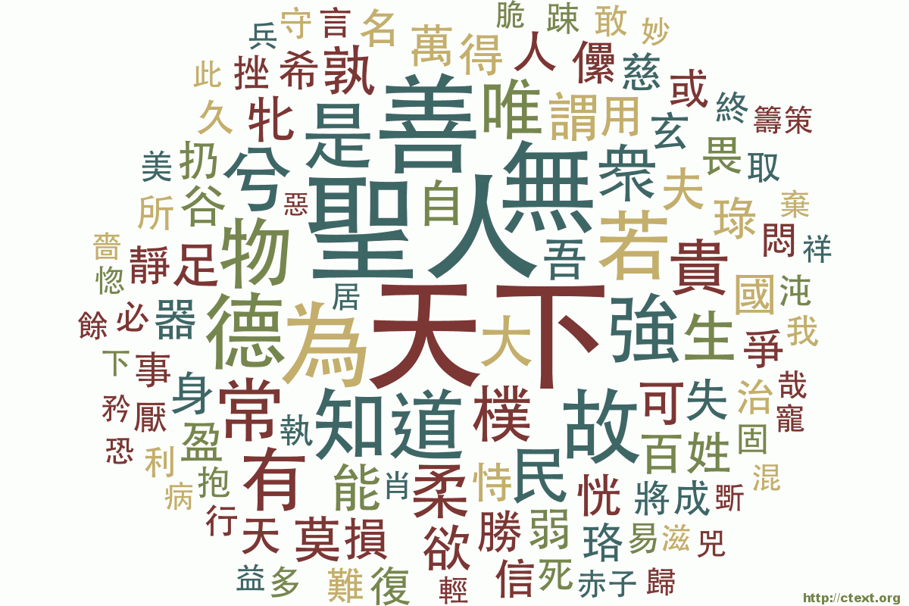

xxx
xxxooovvv
ooo
資料來源
Source of Text
1
Sentiment Analysis
Topic Models
vvv
1a
中文(Chinese)
English
斷字/分詞
(Chinese Word Segmentation)
Ex. CKIP / R / Python
2
6
Corpus
語料庫(Corpus)
推薦Recommendations
資料整理
(Data Organization)
1.Stop words
2.Stemming
3
集群分析Clustering
4
資料矩陣(Data Matrix)
次數Frequency/權重Weighting
Ex. tf / idf / tfidf / entropy
tdm
dtm
關聯規則
Association Rules
視覺化工具(Visualization tool)
Ex.文字雲(Word Cloud)
5
資料分類Classification

Slide 18
Sources of Text
Document Collections

Slide 19
Document Collection
Large volume of textual data
–Billions of documents must be handled in an efficient manner

Slide 20
Text Resources
Email(SPAM、Sentiment)
News Articles
假新聞判斷(呂教授論文)
Web Pages
金管會COSO內部控制資料
首次公開發行公司(IPO)內部控制缺失對財務報導品質之影響
Rumor model from Hotel review(TripAdvisor)
Microblogs
Scientific Articles
Contracts
Patent Portfolios
以往的專利分析只能找到明顯重要的詞，而未能找到不明顯但又會出現的新興詞
Technical Documents
Customer complaint letters
南北故宮、各式博物館、美術館等服務品質資料
Transcripts of phone calls with customers
Call center資料、語氣判斷(文字判斷與聲音判斷)
Lawsuit documents
大法官釋憲爭點
Others
金曲獎分析歌曲分析
國防預算審議議題之探索性研究:從立法院預算中心評估報告進行資料探勘分析

Slide 21
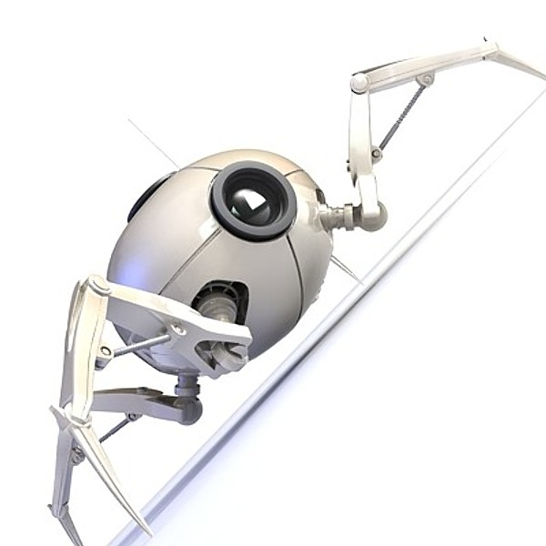
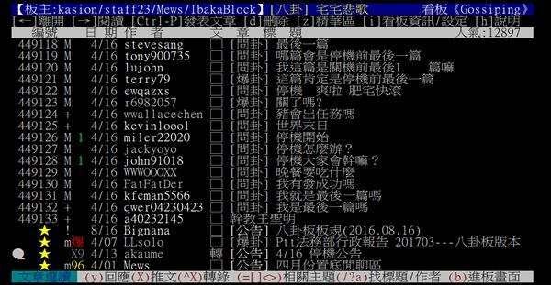
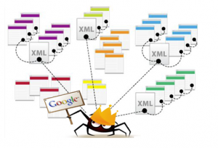


網路爬蟲(Web crawler)
也叫網路蜘蛛（spider）
Ex. ptt

Slide 22
Practice 1
批踢踢網站說明
https://www.ptt.cc/bbs/index.html
Python code for web crawler
Open the file webcrawler4ptt.ipynb on Colab
網路聲量(Social volume/ Internet volume)
Open the file 聲量.ipynb on Colab
(補充)R code for web crawler
Open the file text_R.txt

Slide 23
Text preprocessing
Syntactic/Semantic analysis

Slide 24
Stop Words(停用字)
English: A, ABOUT, ABOVE, ACROSS, AFTER, AGAIN, AGAINST, ALL, ALMOST, ALONE, ALONG, ALREADY, ALSO,…
中文:我、啊、的(現代漢文)、曰(古代漢文)、之(古代漢文) …
Stemming(詞幹化)
learn, learns, learned, learning…
walk, walks, walking, walked…
還好，中文沒這問題!!

Slide 25
Stop Words (停用字)
Stop-words are words that from non-linguistic view do not carry information
…they have mainly functional role
…usually we remove them to help the methods to perform better
Natural language dependent –examples:
English: A, ABOUT, ABOVE, ACROSS, AFTER, AGAIN, AGAINST, ALL, ALMOST, ALONE, ALONG, ALREADY, ALSO, …
中文：我、啊

Slide 26
Stemming(詞幹化)
Different forms of the same word are usually problematic for text data analysis, because they have different spelling and similar meaning
e.g. learns, learned, learning,…
Stemming is a process of transforming a word into its stem (normalized form)

Slide 27
Original text
Information Systems Asia Web -provides research, IS-related commercial materials, interaction, and even research sponsorship by interested corporations with a focus on Asia Pacific region.
Survey of Information Retrieval -guide to IR, with an emphasis on web-based projects. Includes a glossary, and pointers to interesting papers.
After the stop-words removal
Information System Asia Web provide research IS-relate commercial material interaction research sponsorship interest corporation focus Asia Pacific region
Survey Information Retrieval guide IR emphasis web-base project Include glossary pointer interest paper

Slide 28
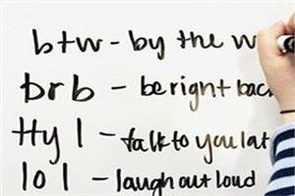


Noise
Noisy data
Spelling mistakes : Aple
Abbreviations: e-commerce
Acronyms: EC
Not well structured text
Email/Chat rooms
- “r u available ?”
“Hey whazzzzzz up”
orz
Multilingual

Slide 29
Chinese Word segmentation
Chinese has word segmentation issues
English uses space to separate words, but Chinese words are linked together
下雨天留客天留我不留
下雨，天留客。天留，我不留
下雨天，留客天。留我不?留。
Word segmentation is a serious issue for Chinese
中研院斷詞系統:http://ckipsvr.iis.sinica.edu.tw/
Python
jieba package
R
jiebaR package

Slide 30
Practice 2
Python code

Slide 31
Feature Generation
Bag of words

Slide 32

Feature Generation: Bag of words(詞袋理論)
Text document is represented by the words it contains (and their occurrences)
e.g., “The Lord of the rings” → {“The”, “the”, “Lord”, “rings”, “of”}
Order of words is not that important
Repitition counts
 | the | lord | ring | of | …
D1 | 2 | 1 | 1 | 1 | …
D2 |  |  |  |  | …
… |  |  |  |  | …

Slide 33
An example
中油吸收5毛漲幅，汽油可望降2元
原先預估要降1.5元的汽油，傳出經濟部要求中油繼續吸收0.5元的漲幅之後，可能可以降到2元，經濟部長也證實，吸收0.5元的漲幅，原則一直沒變，結果加油站上午冷冷清清，不然駕駛人就是只加1百、2百，要等到降價再去加油。
中油(Nc) 吸收(VC) ５(FW) 毛(Nb) 漲幅(Na) ，(COMMACATEGORY) 汽油(Na) 可望(VK) 降(VC) ２(FW) 元(Nf) 原先(D) 預估(VE) 要(D) 降(VC) １(FW) ‧(PERIODCATEGORY) ５(FW) 元(Nf) 的(DE) 汽油(Na) ，(COMMACATEGORY) 傳出(VC) 經濟部(Nc) 要求(VF) 中油(Nc) 繼續(VF) 吸收(VC) ０(FW) ‧(PERIODCATEGORY) ５(FW) 元(Nf) 的(DE) 漲幅(Na) 之後(Ng) ，(COMMACATEGORY) 可能(D) 可以(D) 降到(VJ) ２(FW) 元(Nf) ，(COMMACATEGORY) 經濟部長(Na) 也(D) 證實(VE) ，(COMMACATEGORY) 吸收(VC) ０(FW) ‧(PERIODCATEGORY) ５(FW) 元(Nf) 的(DE) 漲幅(Na) ，(COMMACATEGORY) 原則(Na) 一直(D) 沒(D) 變(VH) ，(COMMACATEGORY) 結果(Dk) 加油站(Nc) 上午(Nd) 冷冷清清(VH) ，(COMMACATEGORY) 不然(Cbb) 駕駛人(Na) 就是(Cbb) 只(Da) 加(VC) １百(Neu) 、(PAUSECATEGORY) ２百(Neu) ，(COMMACATEGORY) 要(D) 等到(P) 降價(VH) 再(D) 去(D) 加油(VB) 。(PERIODCATEGORY)

Slide 34
An example
中油吸收5毛漲幅，汽油可望降2元
原先預估要降1.5元的汽油，傳出經濟部要求中油繼續吸收0.5元的漲幅之後，可能可以降到2元，經濟部長也證實，吸收0.5元的漲幅，原則一直沒變，結果加油站上午冷冷清清，不然駕駛人就是只加1百、2百，要等到降價再去加油。
中油 吸收 ５ 毛 漲幅 汽油 可望 降 ２ 元 原先 預估 要 降 １ ‧ ５ 元 的 汽油 傳出 經濟部 要求 中油 繼續 吸收 ０ ‧ ５ 元 的 漲幅 之後 可能 可以 降到 ２ 元 經濟部長 也 證實 吸收 ０ ‧ ５ 元 的 漲幅 原則 一直 沒 變 結果 加油站 上午 冷冷清清 不然 駕駛人 就是 只 加 １百 ２百 要 等到 降價 再 去 加油

Slide 35
An example
中油 吸收 ５ 毛 漲幅 汽油 可望 降 ２ 元 原先 預估 要 降 １ ‧ ５ 元 的 汽油 傳出 經濟部 要求 中油 繼續 吸收 ０ ‧ ５ 元 的 漲幅 之後 可能 可以 降到 ２ 元 經濟部長 也 證實 吸收 ０ ‧ ５ 元 的 漲幅 原則 一直 沒 變 結果 加油站 上午 冷冷清清 不然 駕駛人 就是 只 加 １百 ２百 要 等到 降價 再 去 加油
中油 吸收 ５ 毛 漲幅 汽油 可望 降 ２ 元 預估 降 １ ‧ ５ 元 汽油 傳出 經濟部 要求 中油 繼續 吸收 ０‧ ５ 元 漲幅 降到 ２ 元 經濟部長 證實 吸收 ０ ‧ ５ 元 漲幅 原則 沒 變 加油站 上午 冷冷清清 駕駛人 加 １百 ２百 降價 加油
Stop word
原先 | 可以 | 就是
要 | 也 | 只
的 | 一直 | 等到
之後 | 結果 | 再
可能 | 不然 | 去

Slide 36
Chinese stop word
Stop word | Stop word | Stop word
一 Neu 58388 | 我 Nh 40332 | 不 D 39014
了 Di 31873 | 他 Nh 30025 | 也 D 29646
就 D 29211 | 人 Na 24269 | 都 D 20403
說 VE 19625 | 我們 Nh 18152 | 你 Nh 17298
要 D 15955 | 會 D 14066 | 很 Dfa 13013
大 VH 11577 | 能 D 11125 | 著 Di 11026
她 Nh 10776 | 還 D 9698 | 可以 D 9670
最 Dfa 9416 | 自己 Nh 9069 | 來 D 8992
所 D 8869 | 他們 Nh 8818 | 兩 Neu 8692
可 D 8508 | 為 VG 8369 | 好 VH 8304
又 D 8037 | 將 D 7858 | 更 D 7298
才 Da 7266 | 已 D 7256 | …
❐ Source: Chapter 7 Text Operations in Hsin-Hsi Chen’s lecture slides

Slide 37
An example
中油 吸收 ５ 毛 漲幅 汽油 可望 降 ２ 元 預估 降 １ ‧ ５ 元 汽油 傳出 經濟部 要求 中油 繼續 吸收 ０ ‧ ５ 元 漲幅 降到 ２ 元 經濟部長 證實 吸收 ０ ‧ ５ 元 漲幅 原則 沒 變 加油站 上午 冷冷清清 駕駛人 加 １百 ２百 降價 加油
Collocations
before | after | before | after
５ 毛 | ５毛 | ２ 元 | ２元
２ 元 | ２元 | ０ ‧ ５ 元 | ０‧５元
１ ‧ ５ 元 | １‧５元 | 沒 變 | 沒變
０ ‧ ５ 元 | ０‧５元
中油 吸收 ５毛 漲幅 汽油 可望 降 ２元 預估 降 １‧５元 汽油 傳出 經濟部 要求 中油 繼續 吸收 ０‧５元 漲幅 降到 ２元 經濟部長 證實 吸收 ０‧５元 漲幅 原則 沒變 加油站 上午 冷冷清清 駕駛人 加 １百 ２百 降價 加油

Slide 38
An example
Term | Freq. | Term | Freq.
中油 | 2 | 降到 | 1
吸收 | 3 | 經濟部長 | 1
５毛 | 1 | 證實 | 1
漲幅 | 3 | 原則 | 1
汽油 | 2 | 沒變 | 1
可望 | 1 | 加油站 | 1
降 | 2 | 上午 | 1
２元 | 2 | 冷冷清清 | 1
預估 | 1 | 駕駛人 | 1
１‧５元 | 1 | 只加 | 1
傳出 | 1 | １百 | 1
經濟部 | 1 | ２百 | 1
要求 | 1 | 等到 | 1
繼續 | 1 | 降價 | 1
０‧５元 | 2 | 加油 | 1

Slide 39
An example
Term | F. | Term | F.
中油 | 2 | 降到 | 1
吸收 | 3 | 經濟部長 | 1
５毛 | 1 | 證實 | 1
漲幅 | 3 | 原則 | 1
汽油 | 2 | 沒變 | 1
可望 | 1 | 加油站 | 1
降 | 2 | 上午 | 1
２元 | 2 | 冷冷清清 | 1
預估 | 1 | 駕駛人 | 1
１‧５元 | 1 | 只加 | 1
傳出 | 1 | １百 | 1
經濟部 | 1 | ２百 | 1
要求 | 1 | 等到 | 1
繼續 | 1 | 降價 | 1
０‧５元 | 2 | 加油 | 1
Term | F. | Term | F.
降價 | 4 | 經濟部長 | 1
吸收 | 3 | 證實 | 1
漲幅 | 3 | 原則 | 1
５毛 | 3 | 沒變 | 1
中油 | 2 | 加油站 | 1
汽油 | 2 | 上午 | 1
２元 | 2 | 冷冷清清 | 1
預估 | 1 | 駕駛人 | 1
１‧５元 | 1 | 只加 | 1
傳出 | 1 | １百 | 1
經濟部 | 1 | ２百 | 1
要求 | 1 | 等到 | 1
繼續 | 1 | 加油 | 1
可望 | 1

Slide 40
An example
d1
Term
降價
吸收
漲幅
５毛
中油
汽油
２元
…
d2
Term
沙拉油
麵粉
漲幅
降價
…
d3
Term
柴油
油電
轎車
…
dn
Term
…
Choose selected index terms form several documents
麵粉
吸收
漲幅
降價
柴油
轎車
…
汽油
沙拉油

Slide 41
An example
麵粉
吸收
漲幅
降價
柴油
轎車
…
汽油
沙拉油
Index term vector
降價 | 吸收 | 漲幅 | 汽油 | 沙拉油 | 麵粉 | 柴油 | 轎車 | …
d₁
1 | 1 | 1 | 1 | 0 | 0 | 0 | 0
d₂
1 | 0 | 1 | 0 | 1 | 1 | 0 | 0
…
d_{n}
In vector representation
1 doc = 1 vector
Each word has its own weights
weights = 1, if doc1 contains word A
weights = 0, if doc1 doesn’t contain word B

Slide 42
Feature Selection

Slide 43
Feature selection
Reduce dimensionality
Learners have difficulty addressing tasks with high dimensionality
Irrelevant features
Not all features help!
e.g., the existence of a noun in a news article is unlikely to help classify it as “politics” or “sport”

Slide 44
Assigning Weights
tf idf measure:
term frequency (tf) * inverse document frequency (idf)
Want to weight terms highly if they are frequent in relevant documents … BUT infrequent in the collection as a whole
Goal: assign a tf * idf weight to each term in each document
Notes:
inverse document frequency (idf) 修正項
N總文件數
Nk出現在哪幾份文件的count
少數幾個文件中出現但出現次數高 代表他超重要

Slide 45
Computing tf-idf -- An Example
Given a document containing terms with given frequencies:
A(3), B(2), C(1)
Assume collection contains 10,000 documents and
document frequencies of these terms are:
A(50), B(1300), C(250)
Then:
A: tf = 3/3; idf = log₂(10000/50) = 7.6; tf-idf = 7.6
B: tf = 2/3; idf = log₂ (10000/1300) = 2.9; tf-idf = 2.0
C: tf = 1/3; idf = log₂ (10000/250) = 5.3; tf-idf = 1.8
Notes:
tf有兩種算法

Slide 46
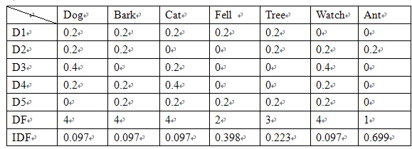
D1: "a dog barks at a cat and it fell from a tree"
D2: "a dog watches ants on the bark of a tree"
D3: "a dog watches another dog watches a cat"
D4: "a dog barks at a cat watches another cat"
D5: "the bark fell from the tree as a cat watches”

Slide 47
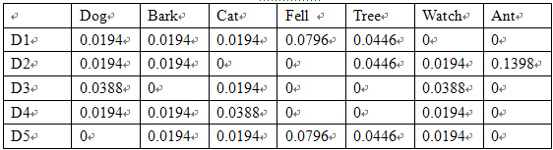
TF* IDF

Slide 48
Practice 3
Python code

Slide 49
Text/Data Mining
Document Similarity
Sentiment of documents

Slide 50
Computing Similarity Among Documents
Advantage of representing documents as vectors is that it facilitates computation of document similarities
Example (Vector Space Model)
the dot product of two vectors measures their similarity
the normalization can be achieved by dividing the dot product by the product of the norms of the two vectors
given vectors X = <x₁, x₂, …, x_{n}> and Y = <y₁, y₂, …, y_{n}>
the similarity of vectors X and Y is:
Note: this measures the cosine of the angle between two vectors

Slide 52
Practice 4
Python code

Slide 53
Analyzing results

Slide 54
Outline
What is text mining
Sources of Text
Text Preprocessing
Feature Generation
Feature Selection
Text Data mining
Analyzing Result
Topic Identification
Notes:
處裡文字是一件很複雜的事情，無法教各位處裡所有的文字，只能分享各位處裡文字個過程而已，然後處裡完文字之後還能做什麼呢?後面還有許多故事

Slide 55
範例一(Example1)
英文text mining，五篇文章
D1:A dog barks at a cat and it fell from a Tree.
D2:A dog watches ants on the bark of a Tree.
D3:A dog watches another dog watches a Cat.
D4:A dog barks at a cat watches another Cat.
D5:The bark fell from the tree as a cat Watches.
 | dog | bark | cat | fell | tree | watch | ant
D1 | 1 | 1 | 1 | 1 | 1 | 0 | 0
D2 | 1 | 1 | 0 | 0 | 1 | 1 | 1
D3 | 2 | 0 | 1 | 0 | 0 | 2 | 0
D4 | 1 | 1 | 2 | 0 | 0 | 1 | 0
D5 | 0 | 1 | 1 | 1 | 1 | 1 | 0
df
idf

Slide 56
範例一(Example1)
D1: "a dog barks at a cat and it fell from a tree"
D2: "a dog watches ants on the bark of a tree"
D3: "a dog watches another dog watches a cat"
D4: "a dog barks at a cat watches another cat"
D5: "the bark fell from the tree as a cat watches"
dog在D1
的tfidf值
 | dog | bark | cat | fell | tree | watch | ant
D1 | 0.2 | 0.2 | 0.2 | 0.2 | 0.2 | 0 | 0
D2 | 0.2 | 0.2 | 0 | 0 | 0.2 | 0.2 | 0.2
D3 | 0.4 | 0 | 0.2 | 0 | 0 | 0.4 | 0
D4 | 0.2 | 0.2 | 0.4 | 0 | 0 | 0.2 | 0
D5 | 0 | 0.2 | 0.2 | 0.2 | 0.2 | 0.2 | 0
df | 4 | 4 | 4 | 2 | 3 | 4 | 1
idf | 0.097 | 0.097 | 0.097 | 0.398 | 0.223 | 0.097 | 0.699
tf
0.0194
idf

Slide 57
tf-idf
dog在D1的tf值
 | dog | bark | cat | fell | tree | watch | ant
D1 | 0.2 | 0.2 | 0.2 | 0.2 | 0.2 | 0 | 0
D2 | 0.2 | 0.2 | 0 | 0 | 0.2 | 0.2 | 0.2
D3 | 0.4 | 0 | 0.2 | 0 | 0 | 0.4 | 0
D4 | 0.2 | 0.2 | 0.4 | 0 | 0 | 0.2 | 0
D5 | 0 | 0.2 | 0.2 | 0.2 | 0.2 | 0.2 | 0
df | 4 | 4 | 4 | 2 | 3 | 4 | 1
idf | 0.097 | 0.097 | 0.097 | 0.398 | 0.223 | 0.097 | 0.699
相乘
dog的
tf-idf值
dog的idf值
 | dog | bark | cat | fell | tree | watch | ant
D1 | 0.0194 | 0.0194 | 0.0194 | 0.0796 | 0.0446 | 0 | 0
D2 | 0.0194 | 0.0194 | 0 | 0 | 0.0446 | 0.0194 | 0.1398
D3 | 0.0388 | 0 | 0.0194 | 0 | 0 | 0.0388 | 0
D4 | 0.0194 | 0.0194 | 0.0388 | 0 | 0 | 0.0194 | 0
D5 | 0 | 0.0194 | 0.0194 | 0.0796 | 0.0446 | 0.0194 | 0

Slide 58
R有預設的tf-idf公式(有加權過不太一樣)
就是R程式碼中的DTM_Rtfidf 變數內容
Terms
Docs ant bark cat dog fell tree watch
1 0.0000000 0.06438562 0.06438562 0.06438562 0.2643856 0.1473931 0.00000000
2 0.4643856 0.06438562 0.00000000 0.06438562 0.0000000 0.1473931 0.06438562
3 0.0000000 0.00000000 0.06438562 0.12877124 0.0000000 0.0000000 0.12877124
4 0.0000000 0.06438562 0.12877124 0.06438562 0.0000000 0.0000000 0.06438562
5 0.0000000 0.06438562 0.06438562 0.00000000 0.2643856 0.1473931 0.06438562
R的預設tfidf計算方法的結果與DM理論上有差距
 | dog | bark | cat | fell | tree | watch | ant
D1 | 0.0194 | 0.0194 | 0.0194 | 0.0796 | 0.0446 | 0 | 0
D2 | 0.0194 | 0.0194 | 0 | 0 | 0.0446 | 0.0194 | 0.1398
D3 | 0.0388 | 0 | 0.0194 | 0 | 0 | 0.0388 | 0
D4 | 0.0194 | 0.0194 | 0.0388 | 0 | 0 | 0.0194 | 0
D5 | 0 | 0.0194 | 0.0194 | 0.0796 | 0.0446 | 0.0194 | 0

Slide 59
範例一(Example1)
myDTM
Terms
Docs bark cat dog fell tree ant watch
1 0.019382 0.01938200 0.01938200 0.079588 0.04436975 0.000000 0.00000000
2 0.019382 0.00000000 0.01938200 0.000000 0.04436975 0.139794 0.01938200
3 0.000000 0.01938200 0.03876401 0.000000 0.00000000 0.000000 0.03876401
4 0.019382 0.03876401 0.01938200 0.000000 0.00000000 0.000000 0.01938200
5 0.019382 0.01938200 0.00000000 0.079588 0.04436975 0.000000 0.01938200
myDTM是透過R程式寫出來的，其結果跟理論上一樣
 | dog | bark | cat | fell | tree | watch | ant
D1 | 0.0194 | 0.0194 | 0.0194 | 0.0796 | 0.0446 | 0 | 0
D2 | 0.0194 | 0.0194 | 0 | 0 | 0.0446 | 0.0194 | 0.1398
D3 | 0.0388 | 0 | 0.0194 | 0 | 0 | 0.0388 | 0
D4 | 0.0194 | 0.0194 | 0.0388 | 0 | 0 | 0.0194 | 0
D5 | 0 | 0.0194 | 0.0194 | 0.0796 | 0.0446 | 0.0194 | 0

Slide 60
範例二(Example2)
D1:The sky is 1-blue.
D2:The 2sun is bright today.
D3:The sun in the sky is 3*bright.
D4:We can see the 4/shining sun, the bright sun.

Slide 61
範例三(Example3)
D1:Data Mining and(&) Social Media Mining.
D2:Social 3Network Analysis.
D3:Data 4-Mining.
D4:Big Data and Data Science.

Slide 62
範例四(Example4)
D1:Two for tea and tea for two.
D2:Tea for me and tea for you.
D3:You for me and me for you.

Slide 63
Computing Similarity Among Documents
Advantage of representing documents as vectors is that it facilitates computation of document similarities
Example (Vector Space Model)
the dot product of two vectors measures their similarity
the normalization can be achieved by dividing the dot product by the product of the norms of the two vectors
given vectors X = <x₁, x₂, …, x_{n}> and Y = <y₁, y₂, …, y_{n}>
the similarity of vectors X and Y is:
Note: this measures the cosine of the angle between two vectors

Slide 64
相似度(Similarity)
Notes:
這張表(矩陣)理論上能做，但是實務上有困難

Slide 65
有沒有辦法可以縮小這一張表格呢?
 | dog | bark | cat | fell | tree | watch | ant | ….
D1 | 0.0194 | 0.0194 | 0.0194 | 0.0796 | 0.0446 | 0 | 0
D2 | 0.0194 | 0.0194 | 0 | 0 | 0.0446 | 0.0194 | 0.1398
D3 | 0.0388 | 0 | 0.0194 | 0 | 0 | 0.0388 | 0
D4 | 0.0194 | 0.0194 | 0.0388 | 0 | 0 | 0.0194 | 0
D5 | 0 | 0.0194 | 0.0194 | 0.0796 | 0.0446 | 0.0194 | 0
…
…
假如有幾萬篇文章，則欄位會變得太多，實務上有些難處理。

Slide 66
Latent Semantics Analysis
想像dims是段落(paragraph)的概念
奇異值分解法
(singular value decomposition，SVD)
Notes:
段落paragraph

Slide 67
Keywords Vs. Topic
 | dog | bark | cat | fell | tree | watch | ant
D1 | 0.0194 | 0.0194 | 0.0194 | 0.0796 | 0.0446 | 0 | 0
D2 | 0.0194 | 0.0194 | 0 | 0 | 0.0446 | 0.0194 | 0.1398
D3 | 0.0388 | 0 | 0.0194 | 0 | 0 | 0.0388 | 0
D4 | 0.0194 | 0.0194 | 0.0388 | 0 | 0 | 0.0194 | 0
D5 | 0 | 0.0194 | 0.0194 | 0.0796 | 0.0446 | 0.0194 | 0
keywords
keywords
topics
keywords
keywords
keywords
…….

Slide 68
範例一(Example1)
英文text mining，五篇文章
D1:A dog barks at a cat and it fell from a Tree.
D2:A dog watches ants on the bark of a Tree.
D3:A dog watches another dog watches a Cat.
D4:A dog barks at a cat watches another Cat.
D5:The bark fell from the tree as a cat Watches.
Find the topics directly.
 | dog | bark | cat | fell | tree | watch | ant
D1 | 0.0194 | 0.0194 | 0.0194 | 0.0796 | 0.0446 | 0 | 0
D2 | 0.0194 | 0.0194 | 0 | 0 | 0.0446 | 0.0194 | 0.1398
D3 | 0.0388 | 0 | 0.0194 | 0 | 0 | 0.0388 | 0
D4 | 0.0194 | 0.0194 | 0.0388 | 0 | 0 | 0.0194 | 0
D5 | 0 | 0.0194 | 0.0194 | 0.0796 | 0.0446 | 0.0194 | 0

Slide 69
Selecting Topics directly
Representing Concept with words require too many features
Animals: Dog, Cat, Ant
Action: Fell, watch
Plant : Tree

Slide 70
Assumption
另外有一群學者認為我們不要再找keywords直接找topics
A document is related to only limited number of topics
(很少有人寫一篇文章會包含30個topics，所以正常人文章沒以幾個topics)
Given a topic, a word is chosen from a limited number of vocabularies in a topic
(大部分的人會先決定大部分的人會先決定topic然後才開始寫，譬如topic為環保Environmental protection，接著所使用的字會環繞著這個topic有關的字，不會超出。)
When writing a document, the author thinks of topics before writing a word. When the topic is decided, a vocabulary is then picked
有沒有辦法直接去計算topic呢?

Slide 71

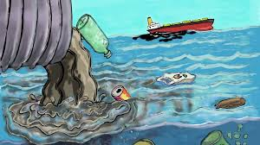
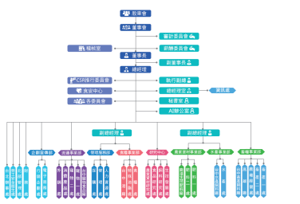

Detect Topics directly
邏輯上已經整理好兩個主題
Given two topics
成立一個委員會來處理汙染

Slide 72

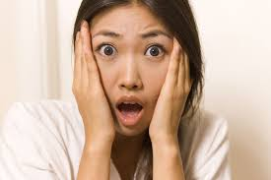
However, we don’t know what are the topics and the exact distribution of documents to topics and topics to words

Slide 73
guess…guess…guess…
Key point:
從document回頭推算有哪些topics，而那些topics包含那些words
If you find a “lead” in a document, how do you guess the topic?
Organization
Poisonous
How often does lead related to organizations in other occurrence
How common is topic organization in the rest of the document

Slide 74
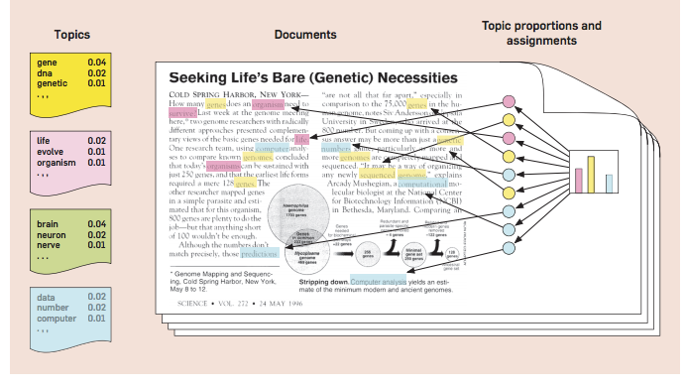
至少一千篇文章，則判讀會比較準
Notes:
去計算字和權重之間的關係

Slide 75
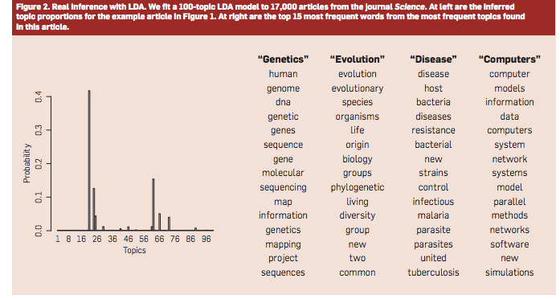

Slide 76
Topic Model

Slide 77
LDA(Latent Dirichlet Allocation)

Slide 78
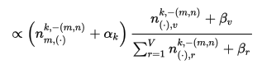

Slide 79
Conclusion
TF-IDF is the most commonly utilized method to identify keywords.
To reduce the number of Keywords, Topic models are popular
Among all the topic models, LSA and LDA are the most popular
Chinese language posts new challenge to text mining due to its word ambiguity and grammar.

Slide 80


From ZERO TO HERO IN R
~Go Go Go Fighting~

